Slide 1

How to create desktop Apps using Java
By – aakash kumar nanda(OCPJP, OCAJP)

Slide 2

Agenda
1. What is Java GUI?
2. What is Java AWT?
3. What is Java Swing?
4. Comparison between AWT and Swing
5. Fun Activity!! Shall we create an app right now?
6. Enough theory right, time to get your hands dirty

Slide 3

Java GUI
GUI, which stands for Graphical User Interface, is a user-friendly visual experience builder for Java applications. It comprises graphical units like buttons, labels, windows, etc. via which users can connect with an application. Swing and JavaFX are two commonly used applications to create GUIs in Java

Slide 4
Java AWT
Stands for Abstract Window Toolkit
Components are platform dependent
Awt components are heavy, uses underlying OS resources
You can create components like buttons checkbox, frames, lists etc

Slide 5
Java Swing
Java Swing tutorial is a part of Java Foundation Classes (JFC) that is used to create window-based applications. It is built on the top of AWT (Abstract Windowing Toolkit) API and entirely written in java.

Slide 6
Java Swing
No. | Java AWT | Java Swing
1) | AWT components are platform-dependent. | Java swing components are platform-independent.
2) | AWT components are heavyweight. | Swing components are lightweight.
3) | AWT doesn't support pluggable look and feel. | Swing supports pluggable look and feel.
4) | AWT provides less components than Swing. | Swing provides more powerful components such as tables, lists, scrollpanes, colorchooser, tabbedpane etc.
5) | AWT doesn't follows MVC(Model View Controller) where model represents data, view represents presentation and controller acts as an interface between model and view. | Swing follows MVC.

Slide 7

Time for an activity!!
What are your favorite desktop based applications that you have used and what are the things that you liked about it!!

Slide 8
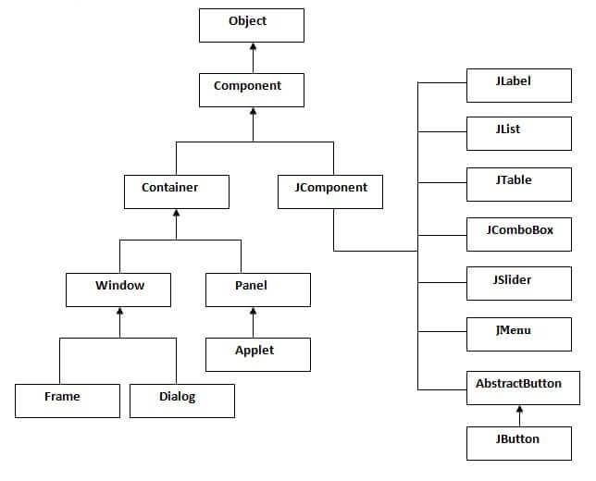
Java Swing Components

Slide 9

Time to Get Our Hands Dirty!!
This Photo by Unknown author is licensed under CC BY-NC-ND.

Slide 10
Reference Links
My Github Repo - https://github.com/aakash1999/javaSwingWorkshop

Slide 11

Thank You!!
Any Questions?

